Slide 1

Introduction to JavaScript
Learning the basics of JS, and creating a gaming application using it.

Slide 2
Prerequisite
Basics of HTML and CSS
Notes:
Maybe a quick recap of the last session?

Slide 3
Learning
Outcome
Basics of JavaScript
Building a gaming application
Basics of CSS

Slide 4
Project
AUDIOVISUAL
INTERACTIVE
DYNAMIC
Adding group video calling to your web application.
Control users in a call using functions like : mute, disable camera, rotating the camera, disconnecting the call.
Creating a layout that adjusts automatically based on the number of users.

Slide 5
Project Assets
Images
Agora SDK
https://www.agora.io/en/wp-content/uploads/2019/06/agoralightblue-1.png
https://docs.agora.io/en/Agora%20Platform/downloads
Tailwind CSS
Google Developer
https://tailwindcss.com/
https://console.developers.google.com

Slide 6

JS

Slide 7
What is JS?
JavaScript is the world's most popular programming language. JavaScript is easy to learn and has wide variety of libraries that are easy to import and use.

Slide 9

<script> tag

Slide 10
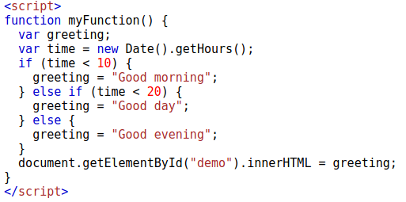
If else condition

Slide 11
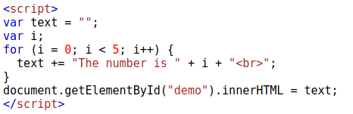
For loop

Slide 12
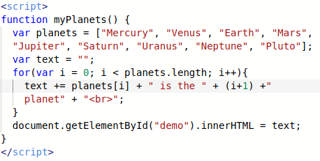
Array

Slide 13
Today’s Project
Snakes Game using JS

Slide 14
Movement

Slide 15
Score Update

Slide 16


THANKS!
Meherdeep Thakur
meherdeept@gmail.com

